Slide 1
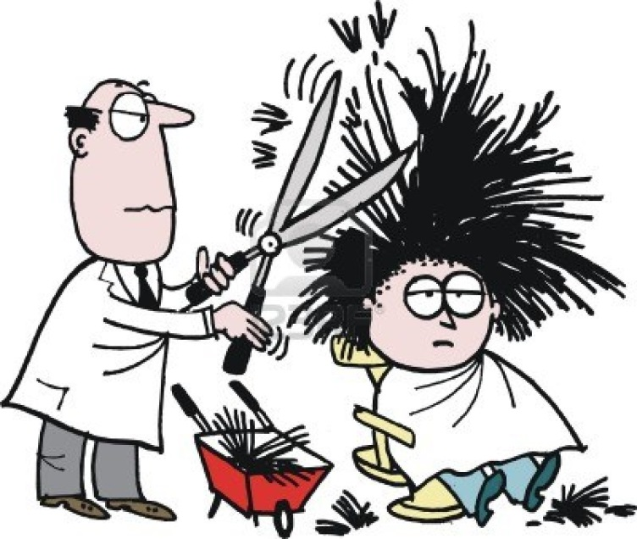
What Percentage of the class have dark hair?

Slide 2

What Percentage of the class have dark hair?
Make a fraction.
$$\frac{Number with dark hair}{Number in the class}$$

Slide 3
Contents
Glossary or Formula Page
Page
Date
Description
2
3

Slide 4
Tasks
24
7
30
Essential Question
Questions
Notes
Summary
4
5

Slide 5
24
7
30
Date
Percentage of a Quantity
EQ – How do we find the percentage of a quantity?
Finding a Percentage of a Quantity
5

Slide 6
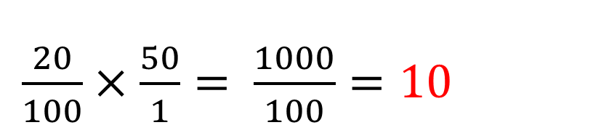
24
7
30
Date
Percentage of a Quantity
EQ – How do we find the percentage of a quantity?
Finding a Percentage of a Quantity
Write the percentage as a fraction out of 100
Change the 'of' to a x
3. Simplify.
Method 1
$\frac{20}{100}×\frac{50}{1}= \frac{1000}{100}=10$
Example: 20% of 50
5

Slide 7
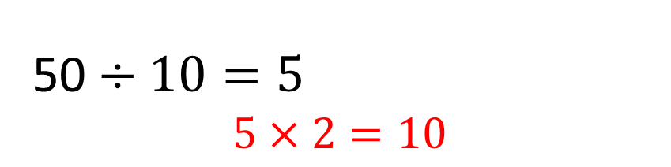
24
7
30
Date
Percentage of a Quantity
EQ – How do we find the percentage of a quantity?
Finding a Percentage of a Quantity
Find 10% of the amount by dividing by 10
2. Then multiply by 2 for 20%
( or 3 for 30% etc. If you need 5%, halve the 10% amount)
Method 2
50 $÷10=5$
$$5×2=10$$
Example: 20% of 50
5

Slide 8


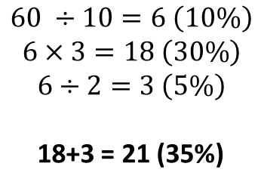


24
7
30
Date
Percentage of a Quantity
EQ – How do we find the percentage of a quantity?
Method 1 Method 2
Find 20% of 65
$$\frac{20}{100}×\frac{65}{1}=\frac{1300}{100}$$
$$65÷10=6.5 \left(10\%\right)$$
$$6.5 ×2$$
$$=13$$
= 13
Find 35% of 60
$$\frac{35}{100}×\frac{60}{1}= \frac{2100}{100}$$
$$60 ÷10=6 \left(10\%\right)$$
$$6×3=18 \left(30\%\right)$$
$$6÷2=3 \left(5\%\right)$$
18+3 = 21 (35%)
= 21
5

Slide 9
Word Problem
The recommended daily amount of Vitamin C for Children 9-13 years old is 45 mg. A serving of juice contains 60% of the recommended amount.
How many mg of Vitamin C does the juice drink have?

Slide 10
Word Problem
The recommended daily amount of Vitamin C for Children 9-13 years old is 45 mg. A serving of juice contains 60% of the recommended amount.
How many mg of Vitamin C does the juice drink have?
27 mg

Slide 11
Dwyer textbook
Page 6
Complete Exercise 1.5 Questions 1 to 24

